Slide 1

Subject: Application Development Subject teacher: Nguyen Trung Thuan (Title: Regional Director of Central & Central Highlands
Presentation on topic: E-commerce website selling online
Prepared by group 7

Slide 2












Our group of 7:
Pham Tan Quoc
Le Viet Kha
Pham Van Dong (group leader)
Dao Ngoc Hieu
Le Huy Hoang

Slide 3

Today, as technology develops strongly and digital transformation takes place increasingly strongly in business, more and more businesses have begun to deploy online sales websites. Understanding the goals of a sales website will make it easier for businesses to establish construction and operation methods to increase sales, revenue and profit on the online platform. .
Are you planning to create your own online sales channel?

Slide 4

What is a sales website all about?
A sales website is a website that provides space for businesses and customers to conduct transactions to buy, sell, and exchange products and services online. For example, when accessing these websites, users will easily search and consult detailed information about products and services, then quickly place orders, confirm and pay. quickly.
That is also the reason why online shopping activities (ie Online Shopping) are becoming more and more popular today and it has become extremely important for businesses to build themselves an online sales website.

Slide 5
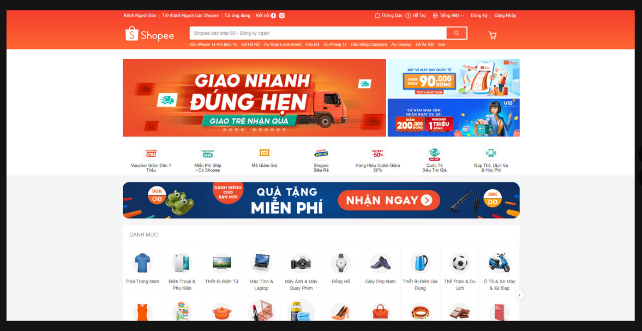
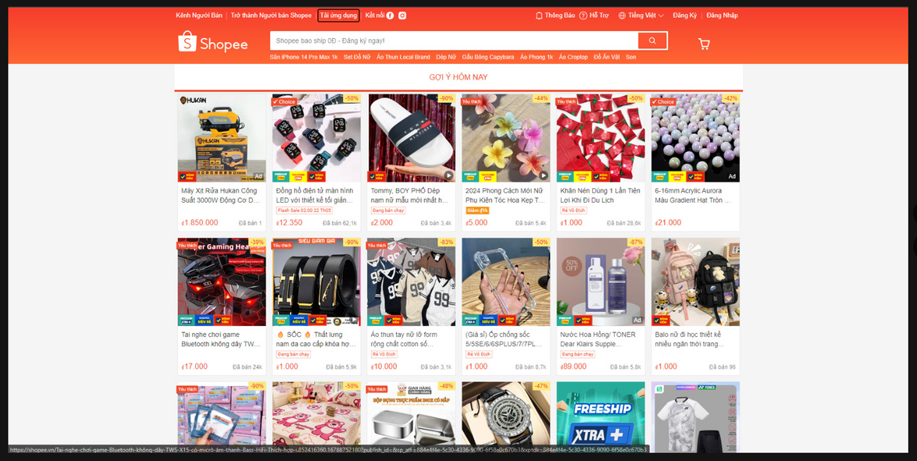
Shopee is an e-commerce trading platform headquartered in Singapore, owned by Sea Ltd (formerly Garena), founded in 2009 by Bruce Lee. Shopee was first introduced in Singapore in 2015, and is currently available in the following countries: Singapore; Malaysia, Taiwan, Thailand, Indonesia, Vietnam, Philippines, Brazil, Poland.
As of 2021, Shopee is considered the largest e-commerce platform in Southeast Asia with 343 million monthly visits. Additionally, Shopee serves consumers and sellers across countries in East Asia and Latin America.[2][3]

Slide 6
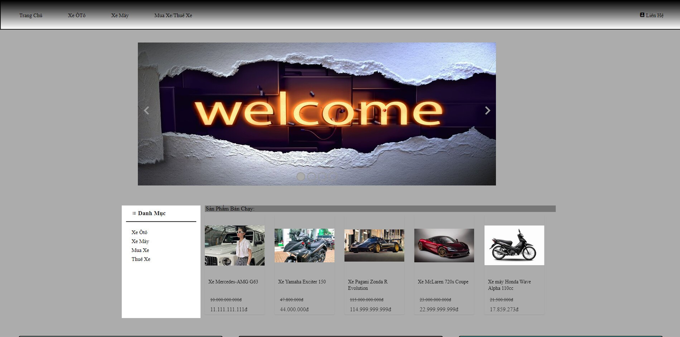
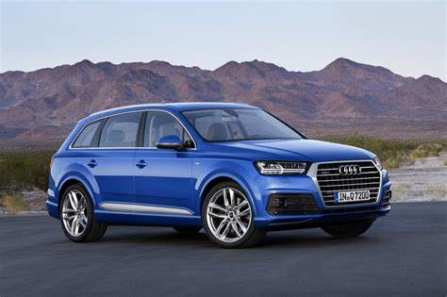
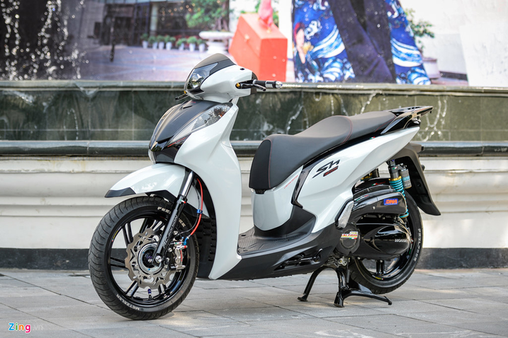
Based on online sales websites such as shoppe and other websites, we have created a website to buy, sell and import all kinds of motorbikes, electric vehicles and cars.
This is our website when we refer to other websites and come up with our own creativity when creating a website to sell cars online.

Slide 7
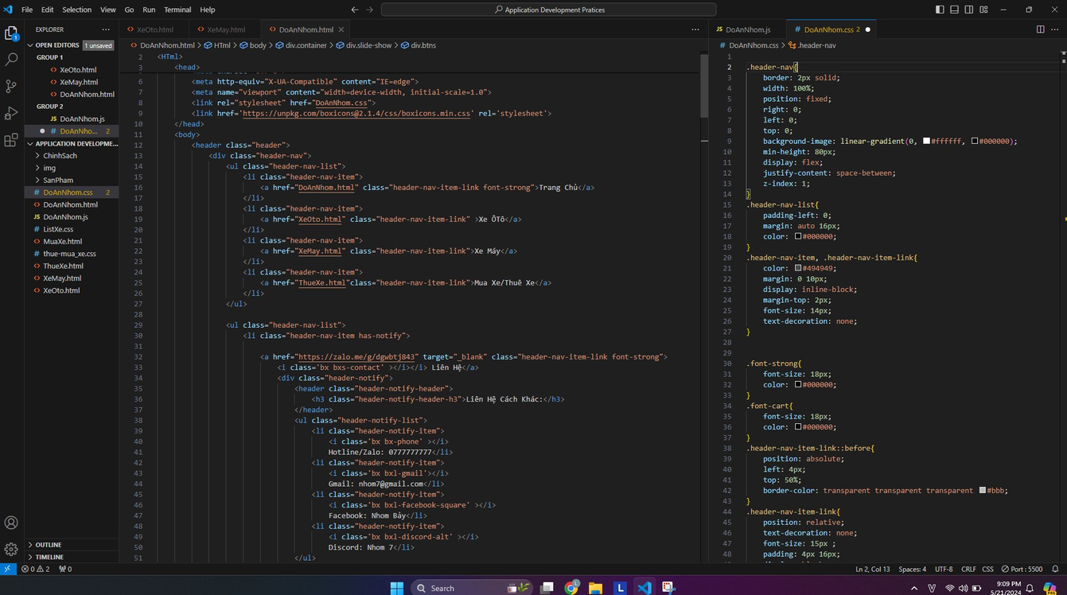

In the first step, this is the code where we created the body of the car sales section and the price list of the cars.

Slide 8
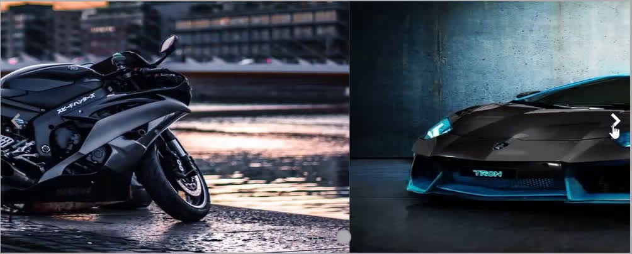
Here is our slide show!

Slide 9
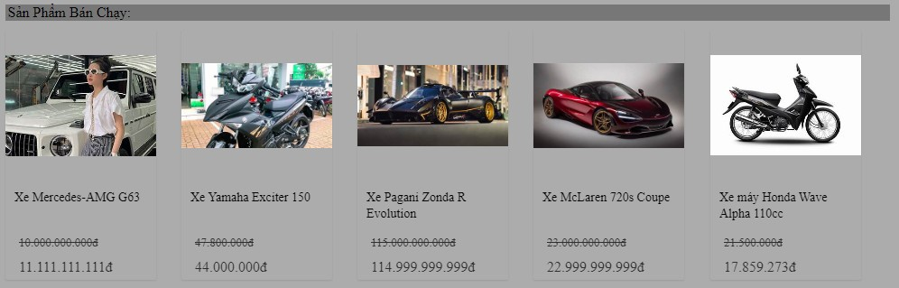
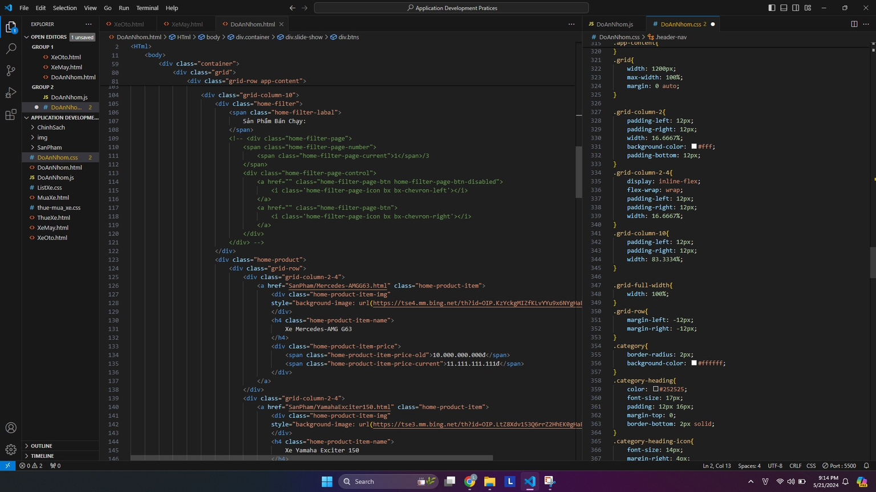
Our best-selling car product section.

Slide 10
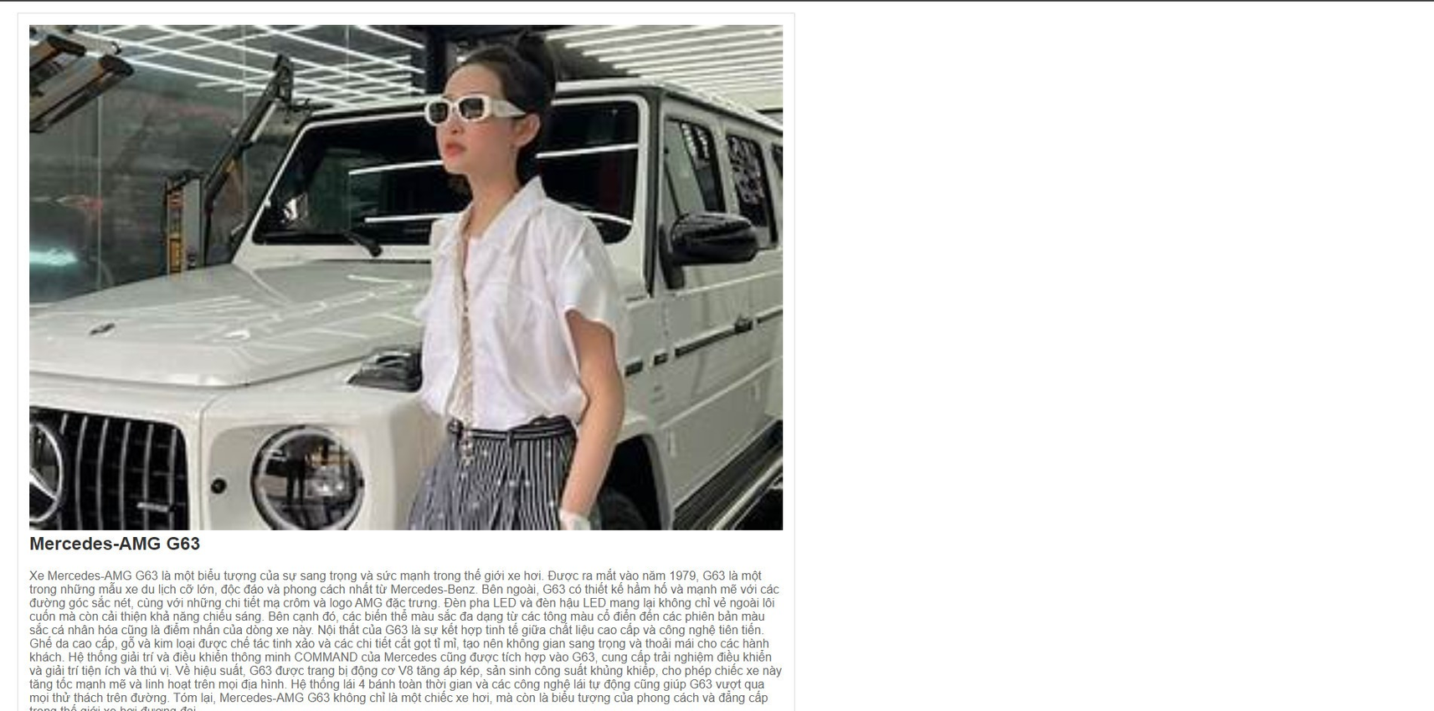
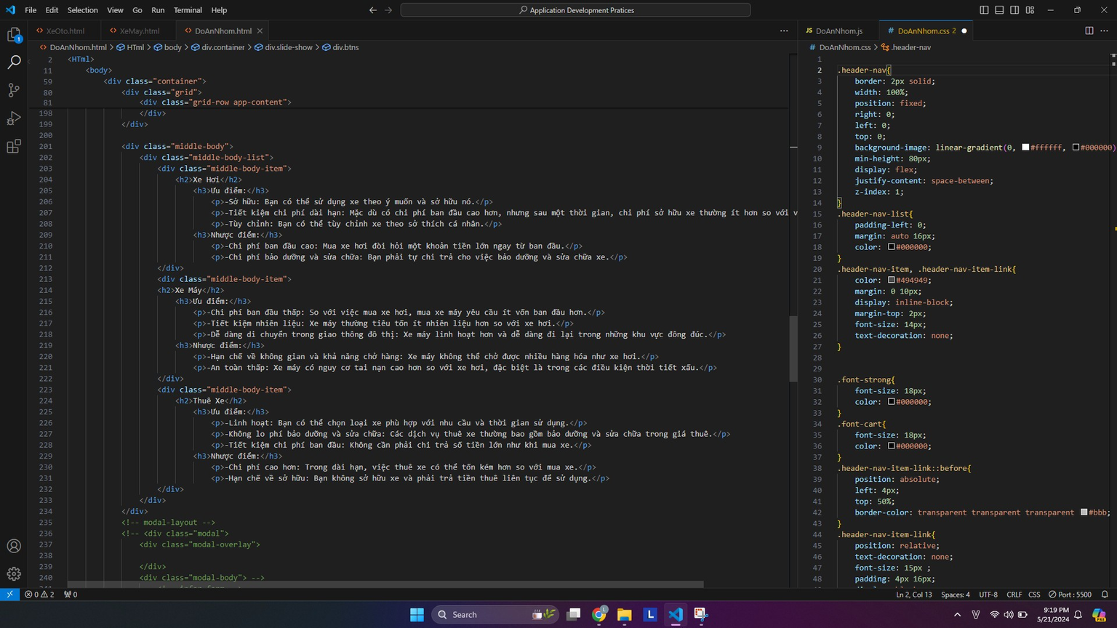
Introduction to vehicle services.

Slide 11


Middle -Body part

Slide 12
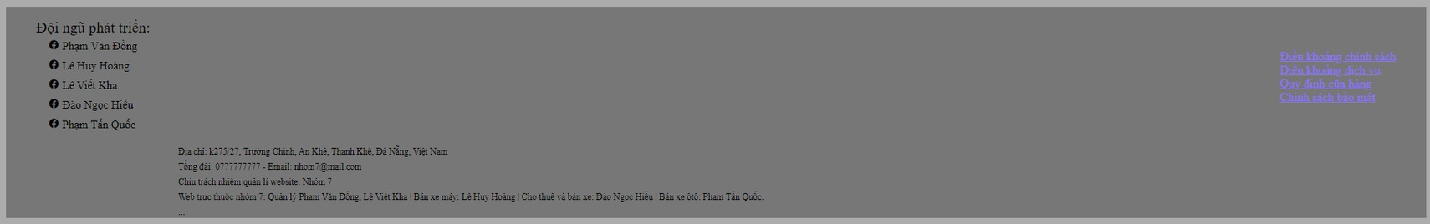
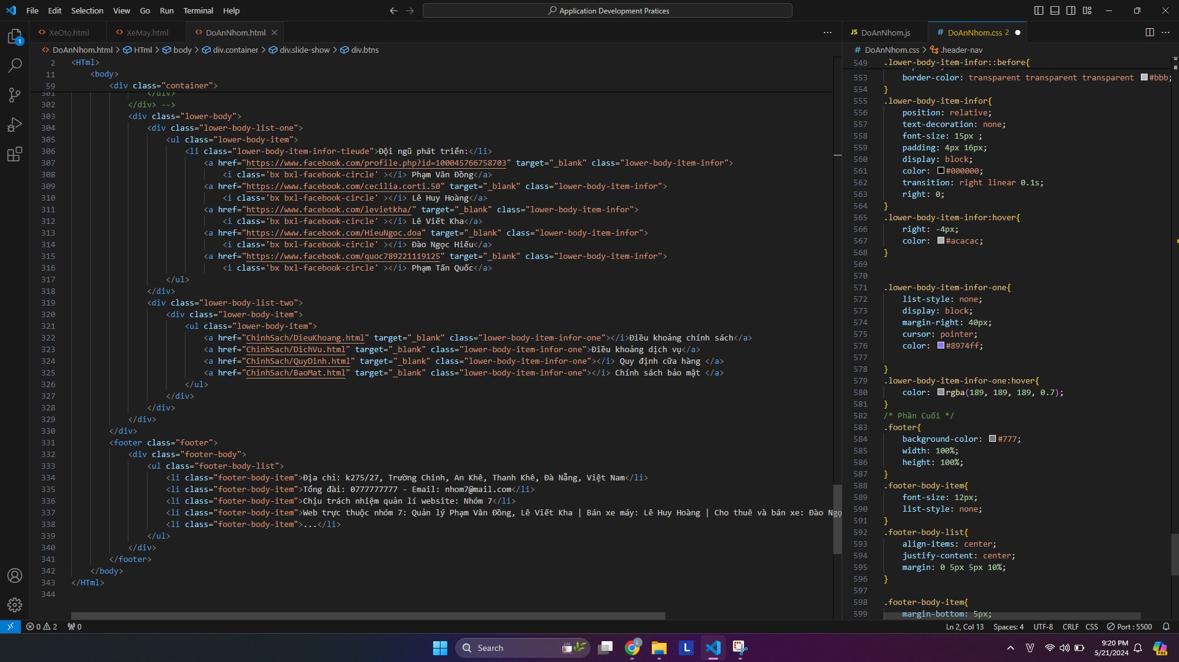
This is essential information and makes it easy for users to find what they need.
(including store information and development team information).

Slide 13
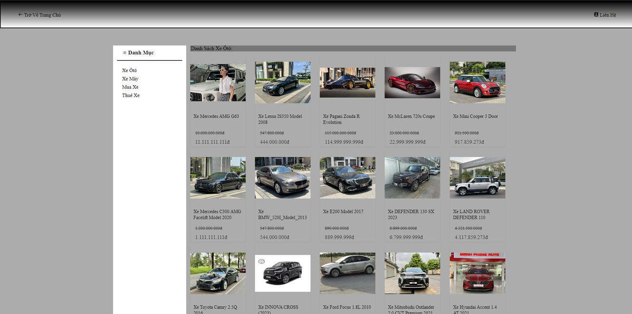
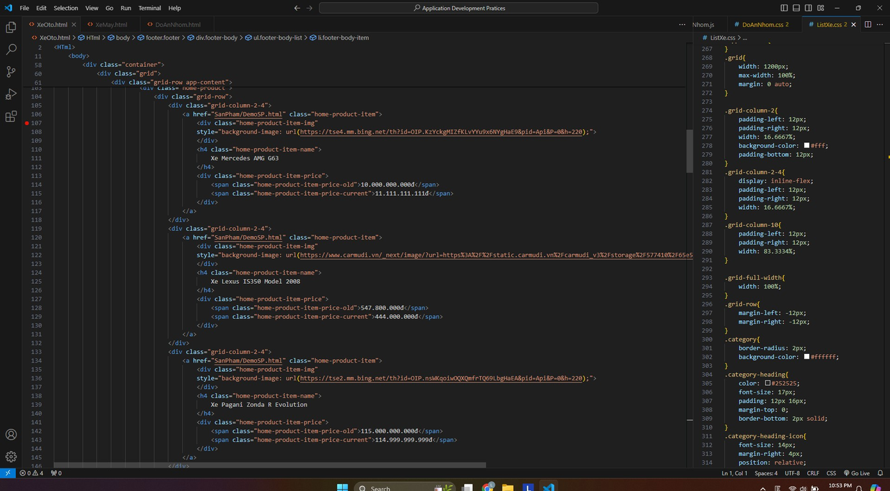
The catalog includes motorbikes, cars, car rentals, and car purchases.

Slide 14

Part of car products delivered for sale.

Slide 15
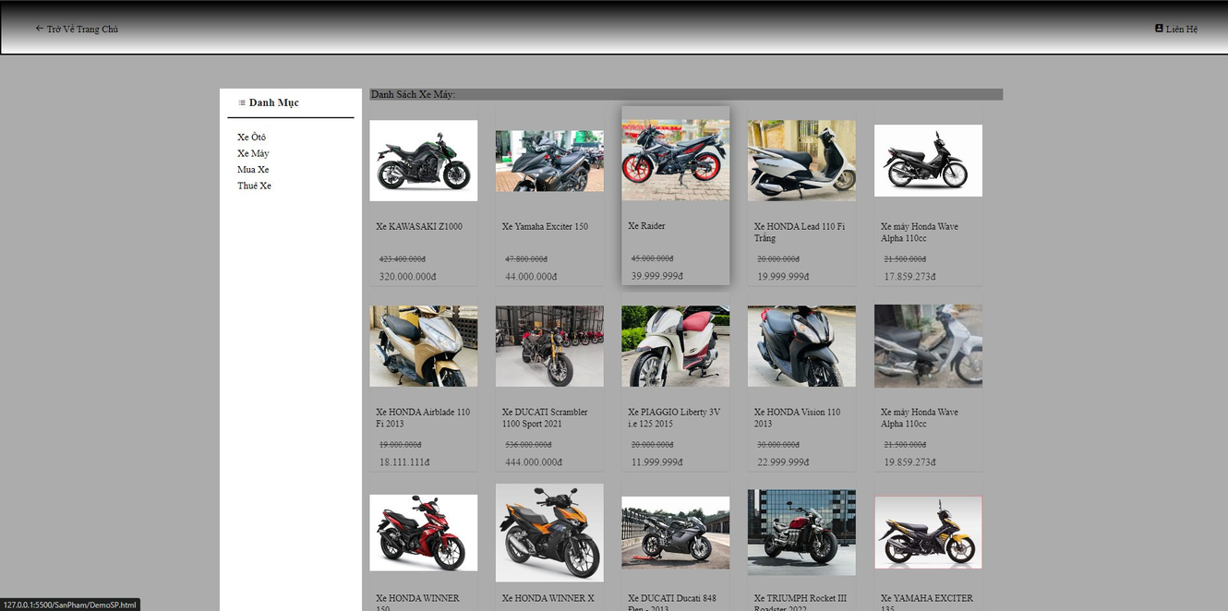
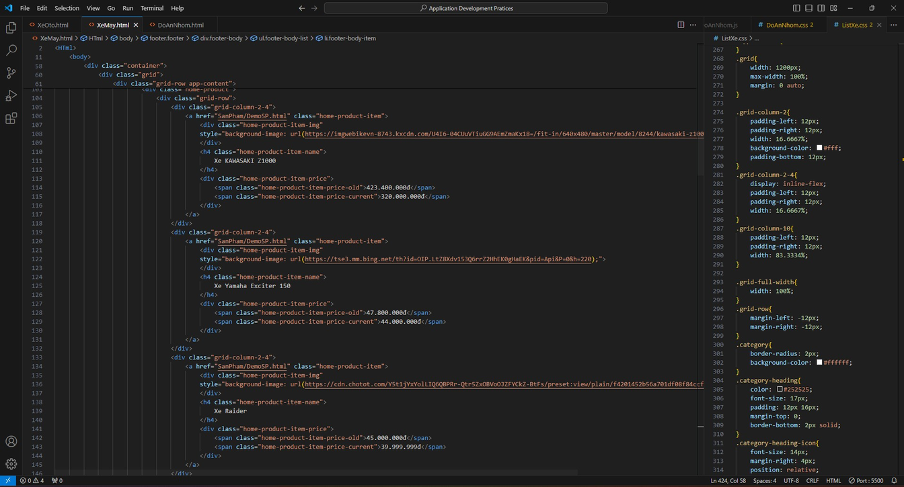
Part of motorbikes for sale.

Slide 16
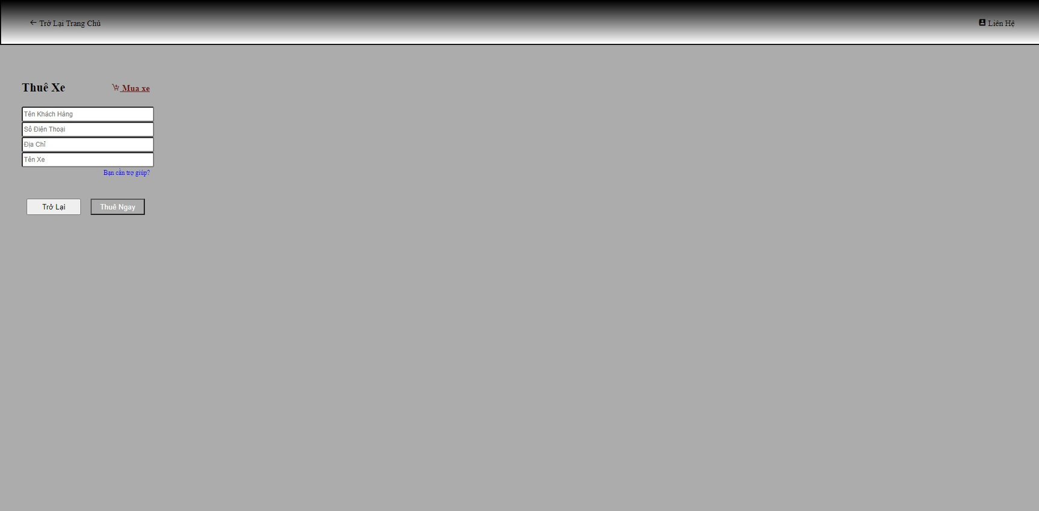
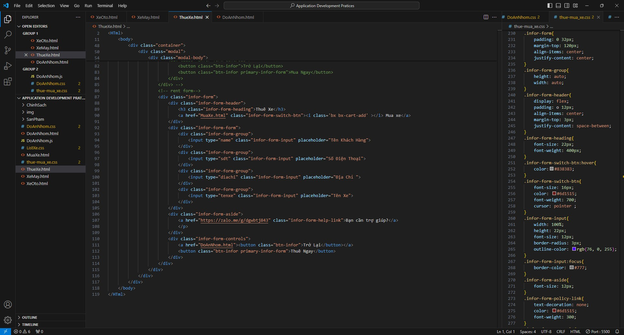
Rental of motorbikes and cars according to customer requirements.

Slide 17
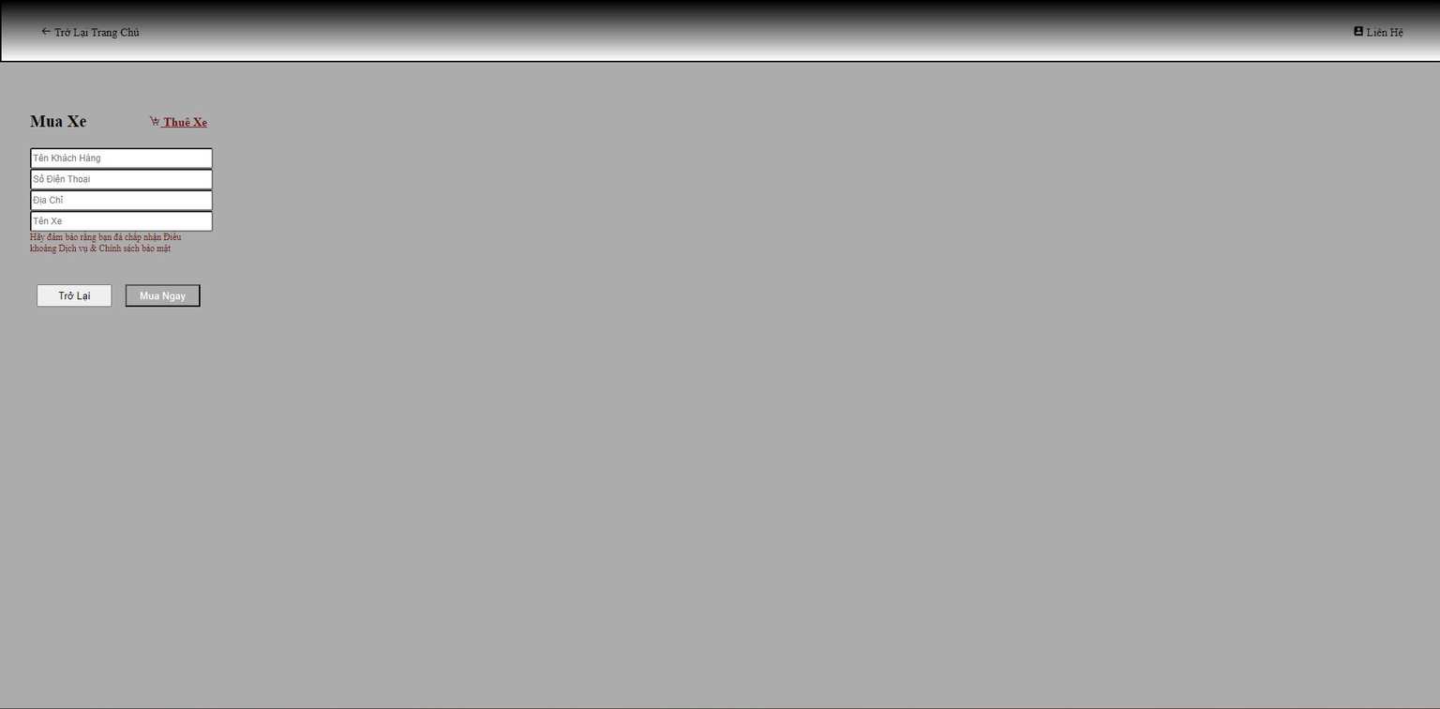
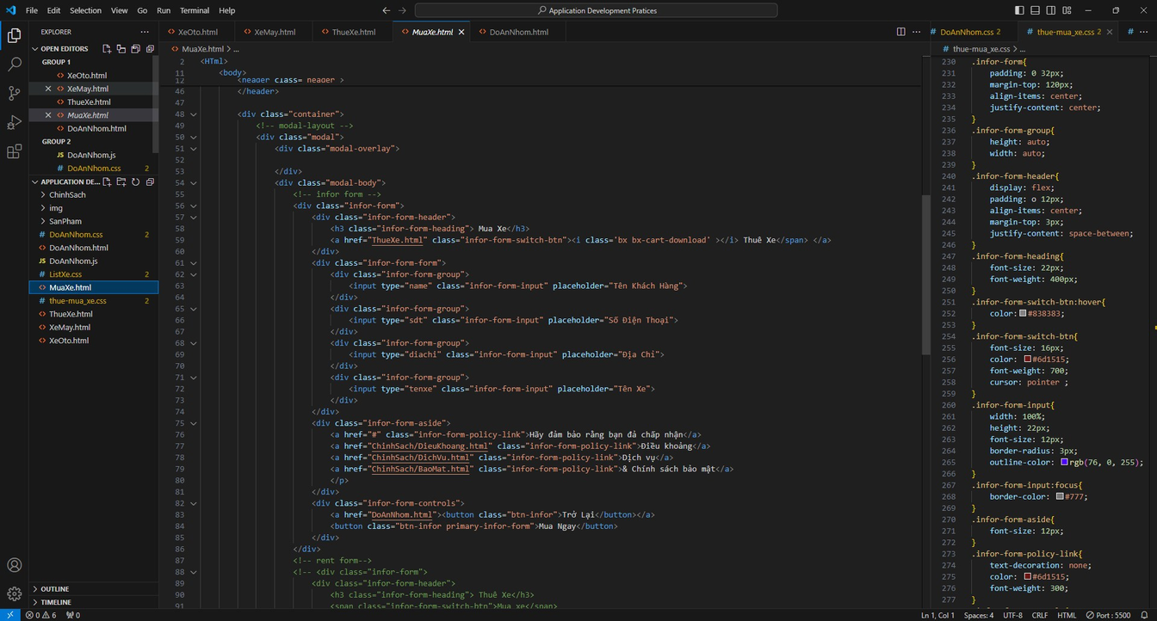
This is the part where customers buy cars that are satisfactory to them.

Slide 18

Thank
you for
watching

